Slide 1
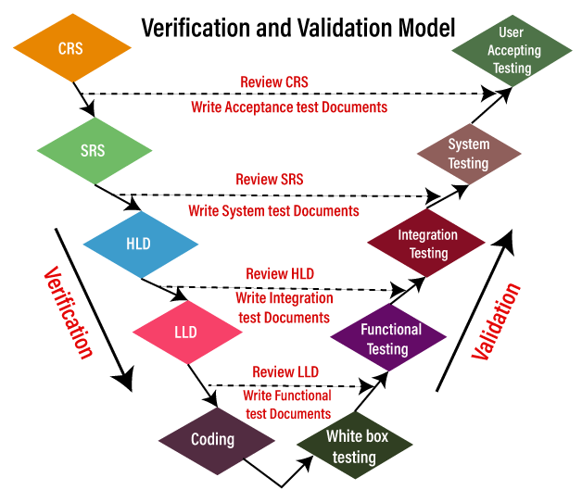
V and V Model Process
Notes:
Verification -> Static Testing by referring to documents Validation-> Dynamic Testing on application

Slide 2
Advantage and Disadvantage of V and V Model
Advantages | Disadvantages
In this, review exists in every phase, that's why we may get less number of bugs in the application. | It is a bit expensive process because Initial investment is high as the testing team is needed from the starting stage itself.
The V model provides the Parallel deliverable, which implies that the two teams can work together like here; the development and testing team are working parallelly. | It is a time-consuming process because if requirement changes happen, we need to change every text documents.
This model helps to deliver Robust or stable products. | In this, we need to do more documentation work because of the test cases and all other documents.
In this model, the test Engineers have more knowledge about the product because testing is involved in every stage of product development. | The V model is not suitable for object-oriented projects.
The text document can be re-used. | We cannot go back and replace the functionality once the application is in the testing phase

Slide 3
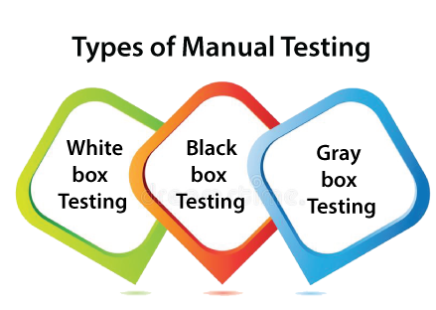
Manual Testing
Manual testing is a software testing process in which test cases are executed manually without using any automated tool.
All test cases executed by the tester manually according to the end user's perspective.
It ensures whether the application is working, as mentioned in the requirement document or not.
Manual Testing is one of the most fundamental testing processes as it can find both visible and hidden defects of the software.
The difference between expected output and output, given by the software, is defined as a defect.

Slide 4
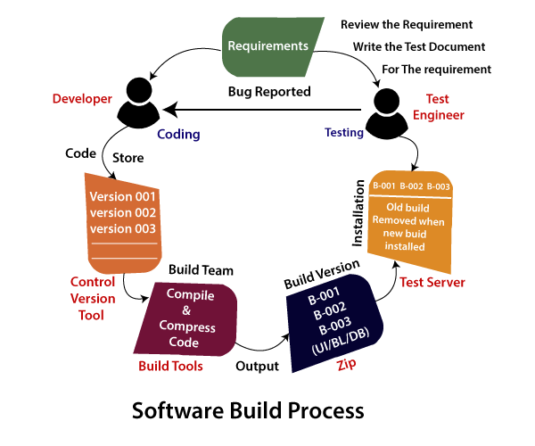
Software Build Process

Slide 5
Advantages and Disadvantages of Manual Testing
Advantages of Manual Testing
It does not require programming knowledge while using the Black box method.
It is used to test dynamically changing GUI designs.
Tester interacts with software as a real user so that they are able to discover usability and user interface issues.
It ensures that the software is a hundred percent bug-free.
It is cost-effective.
Easy to learn for new testers.
Disadvantages of Manual Testing
It requires a large number of human resources.
It is very time-consuming.
Tester develops test cases based on their skills and experience. There is no evidence that they have covered all functions or not.
Test cases cannot be used again. Need to develop separate test cases for each new software.
It does not provide testing on all aspects of testing.
Since two teams work together, sometimes it is difficult to understand each other's motives, it can mislead the process.

Slide 6
Automation Testing
When the testing case suites are performed by using automated testing tools is known as Automation Testing.
The testing process is done by using special automation tools to control the execution of test cases and compare the actual result with the expected result. Automation testing requires a pretty huge investment of resources and money.
The life cycle of Automation Testing

Slide 7
Advantages and Disadvantages of Automation Testing
Advantages of Automation Testing
Automation testing takes less time than manual testing.
A tester can test the response of the software if the execution of the same operation is repeated several times.
Automation Testing provides re-usability of test cases on testing of different versions of the same software.
Automation testing is reliable as it eliminates hidden errors by executing test cases again in the same way.
It does not require many human resources, instead of writing test cases and testing them manually, they need an automation testing engineer to run them.
The cost of automation testing is less than manual testing because it requires a few human resources.
Disadvantages of Automation Testing
It requires high-quality testing tools and requires high-level skilled testers.
When it encounters an unsuccessful test case, the analysis of the whole event is complicated.
Test maintenance is expensive because high fee license testing equipment is necessary.
Debugging is mandatory if a less effective error has not been solved, it can lead to fatal results.

Slide 8
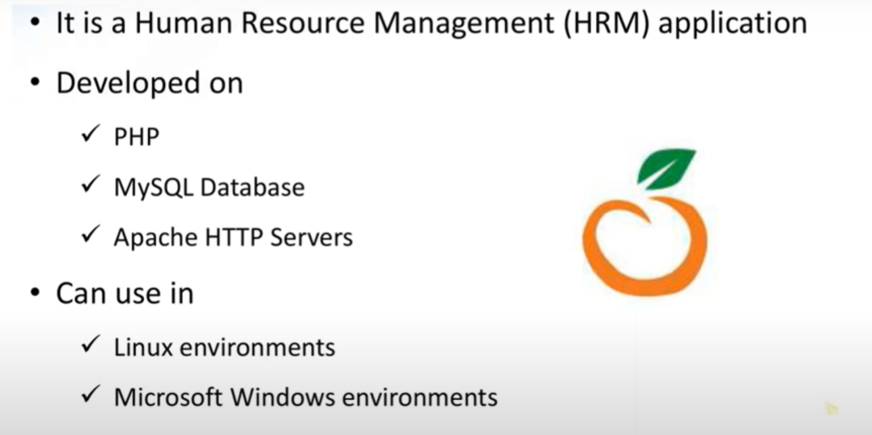
HRMS Application - https://opensource-demo.orangehrmlive.com/index.php/auth/login

Slide 9
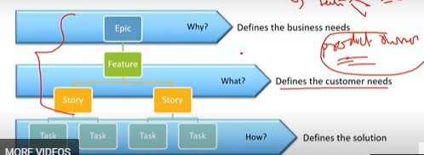
Agile Process

Slide 10
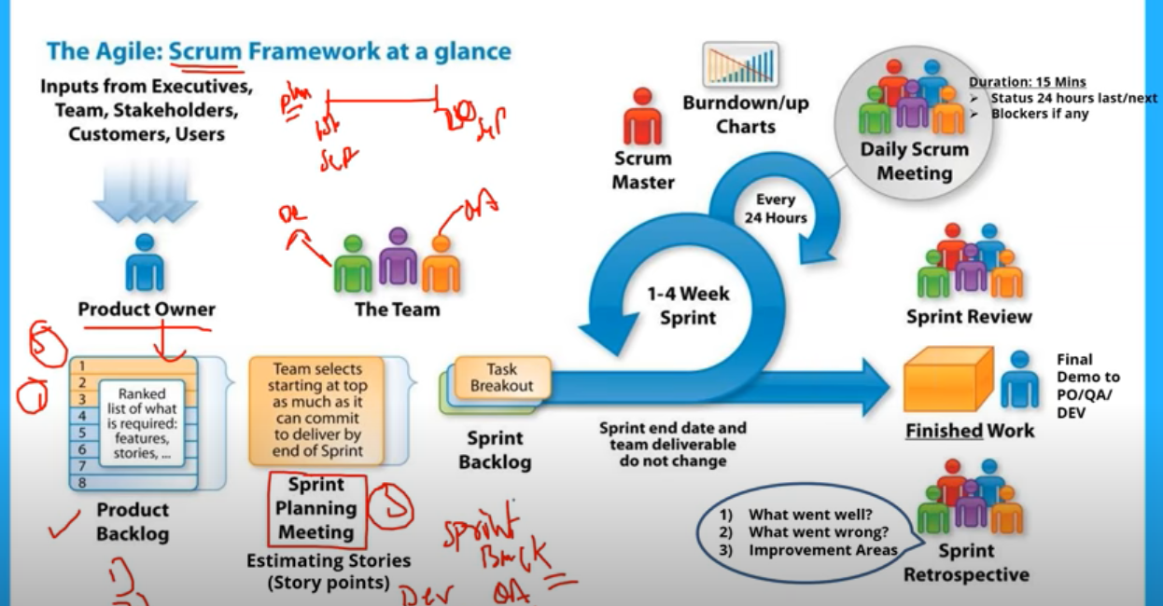
Agile Process
Notes:
Sprint-1 -> 3 or 4 tasks, 2 to 3 weeks
Sprint-2 -> other tasks are assigned and continue
Scope for improvement in every sprint cycle

Slide 11
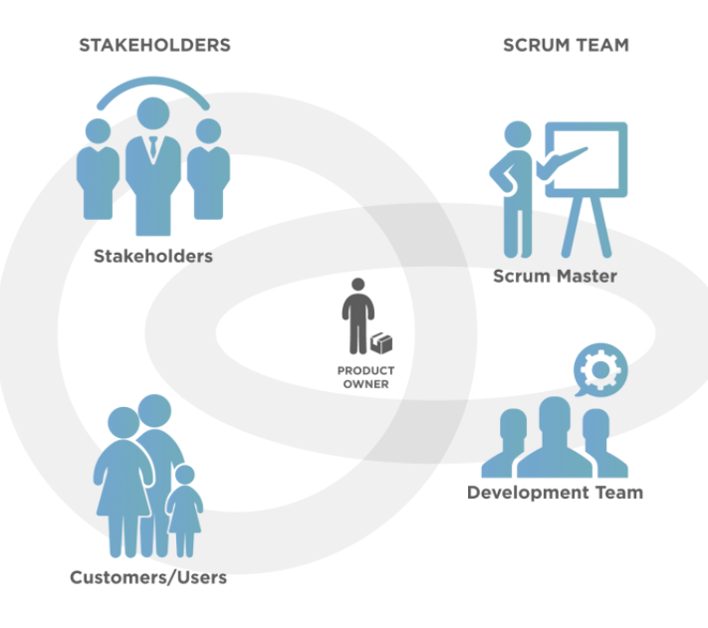

Slide 12



Day-1
Sprint meeting – Day-1 Scrum Master based on the req & complexity
Duration of the sprint 2- 2 weeks – 10 working days
Stake Holder – Customer/end user
Scrum Master -
Scrum Team (Dev & Test)
User Stories
Standup meeting
End of sprint ?

Slide 13
TODO | InProgress | Done

Slide 14
Requirements
Test & FeedBack
Architecture & Design
Development

Slide 15
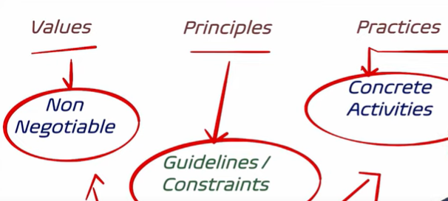
Extreme Programming
Notes:
https://www.youtube.com/watch?v=uBPVmjJVu0E
https://www.altexsoft.com/blog/business/extreme-programming-values-principles-and-practices/

